Slide 1

Predicting Animal Shelter Outcomes
Drop It!
Joe Brady
MSBA – Machine Learning
Final Project Presentation

Slide 2
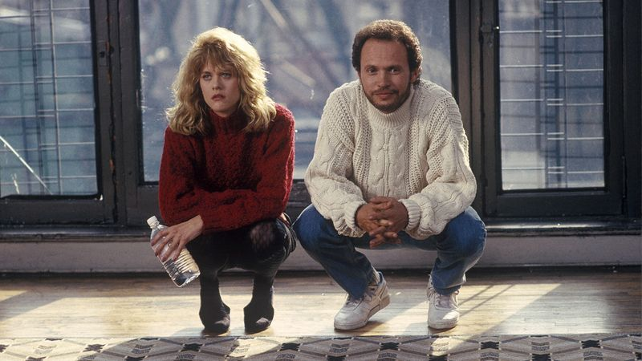
Works Cited
Fit inspo:
Billy Crystal

Slide 3
Too many pets are not adopted or spend too long waiting in the shelter
We all know that some breeds are stereotypically favored (labradors), while some are not (pit bulls)
people usually want puppies over senior dogs
How powerful are these factors? What else plays a role? Coat color? Time of year?

Slide 4
I framed this problem as 3 questions to model
Predict the outcome of an animal (adoption, return to owner, transfer, or euthanasia)
Predict the time it takes for an animal to be adopted
Identify what are the strongest factors that make an animal more or less likely to be adopted

Slide 5
I framed this problem as 3 questions to model
Predict the outcome of an animal (adoption, return to owner, transfer, or euthanasia)
Tuned XGBoost multiclass model
Predict the time it takes for an animal to be adopted
Tuned XGBoost gamma deviance model
Identify what are the strongest factors that make an animal more or less likely to be adopted
non-tuned XGBoost logistic regression model

Slide 6
The dataset I used was from the Austin Animal Center, from 2013-2025
Pros
Large dataset, 220,000 rows!
65,000 are duplicates…
13 predictive features – breed, color, age, intake type, intake condition, and on
Cons
65,000 Duplicate animals
Similar data, but conflicting entries
entry error, or returning animal?
No behavioral data
likely a strong factor for adoption outcomes
Data is only from one location
model generalization might be limited
how does geography play a role?

Slide 7
The final cleaned dataset has 13 predictors and 2 response variables
Feature | Type | Description
animal type | Predictive | Dominated by dog and cat class; other animals are a minority
breed | Predictive | Examples: labrador retriever (dog), maine coon (cat), cottontail (rabbit)
purebred | Predictive | 1 or 0 depending on if the dog is only one breed or a mix of breeds
color | Predictive | Coat color; black, tan, brindle, etc
Intake reason | Predictive | Context for intake. stray, owner surrender, public assist, wildlife, etc
intake condition | Predictive | Any abnormalities upon intake. Normal, injured, nursing, etc.
age | Predictive | Age in years of the animal
gender | Predictive | Male, female, or unknown (usually unknowns are wildlife)
sterilization status | Predictive | Intact or sterilized (i.e. spayed/neutered)
Outcome year | Predictive | Year of outcome. Used to identify potential trend in outcomes
Outcome month | Predictive | Month of outcome. Used to identify potential seasonality in outcome. Transformed into sin and cos components
Outcome weekday | Predictive | Weekday of outcome. Used to identify potential seasonality within a week of outcomes. Example: a popular day for adoption
Shelter stay duration | Predictive/Response | Time between intake and outcome. Predictive for models where outcome type is the response variable. Response variable for one model.
Outcome type | Response | Outcome class: adoption, euthanasia, return to owner, transfer.

Slide 8
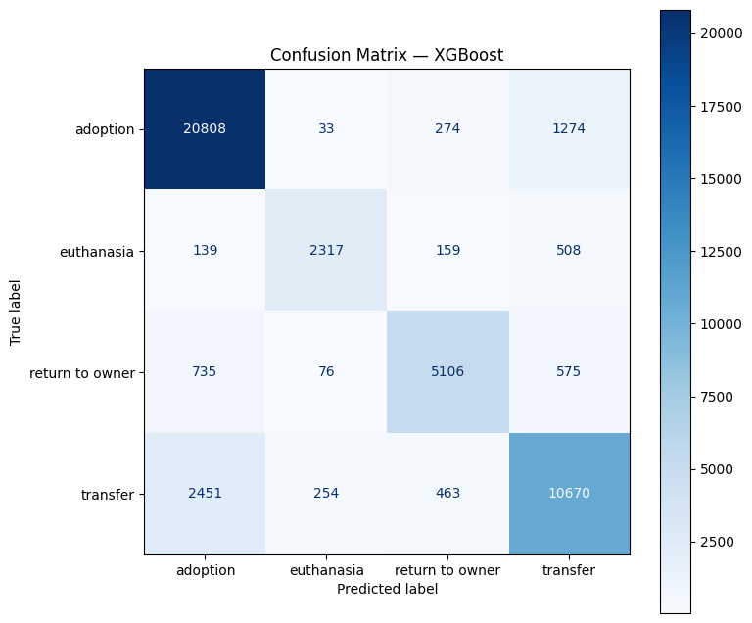
Model 1 predicts outcome classification for animals
Training set accuracy: 98.6%
Test set accuracy: 84.9%
Factor strength difficult to extract for multiclass
will be highlighted with other models

Slide 9
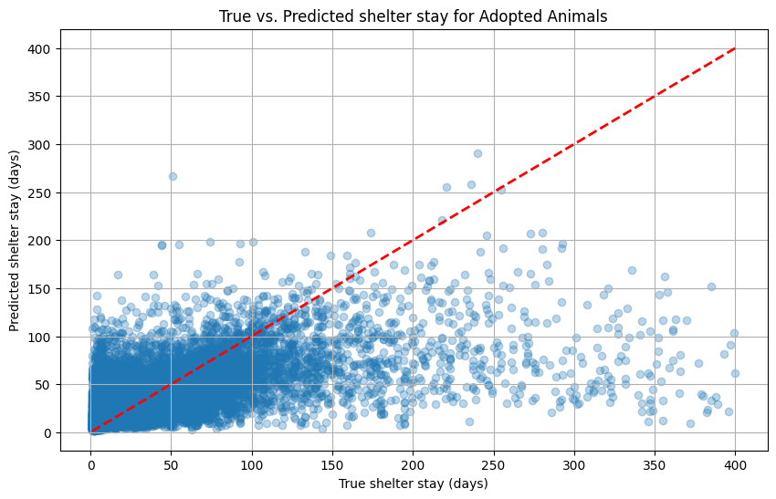
Model 2 predicts the time it takes until an animal gets adopted
Training set gamma deviance: 15.59
Test set gamma deviance: 19.59
Null deviance: 40.33

Slide 10

What is gamma deviance?
Good for datasets with response variables greater than 0 and right skew
wait times, insurance payouts, and shelter stays
Fails for data that is extremely right-skewed
Null deviance – deviance if we just used the mean value of the response variable to guess
My model’s test deviance is 52% better than null – 52% better than a basic guess using the mean

Slide 11
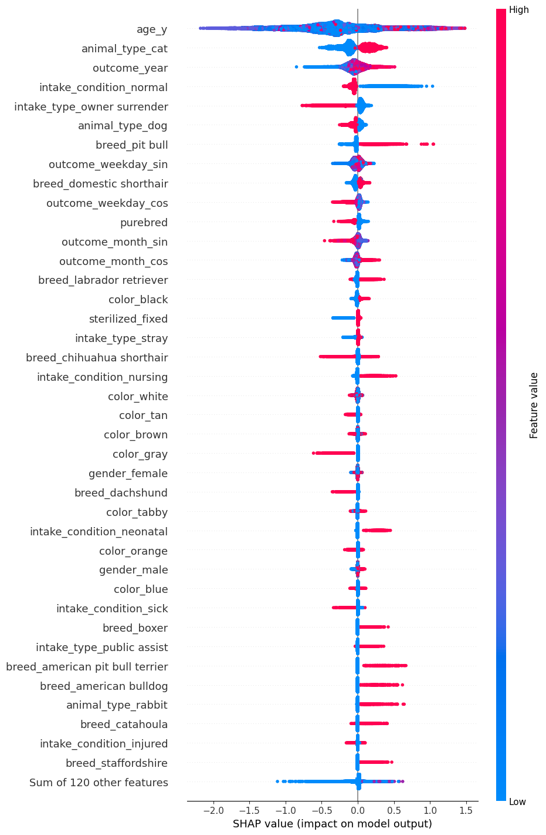
The most impactful features for the gamma deviance model
older animals have longer stays
dogs are adopted quicker than cats
non-injured animals are adopted quicker
previously homed pets (‘owner surrender’) are adopted faster than strays
pit bulls and labs stay longer, and purebreds are adopted quicker
black coated animals stay longer

Slide 12
Secondary impactful features for the gamma deviance model
grey animals adopted quicker
dachshunds adopted quicker
boxers, bulldogs, staffies stay longer
rabbits stay longer
animals that are sick upon intake are adopted quicker

Slide 13
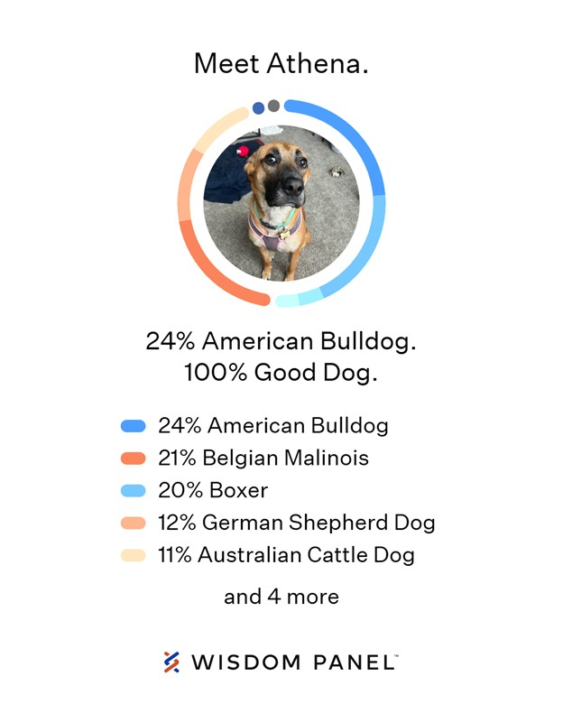
What would the gamma deviance model predict for my dog, Athena?

Slide 14
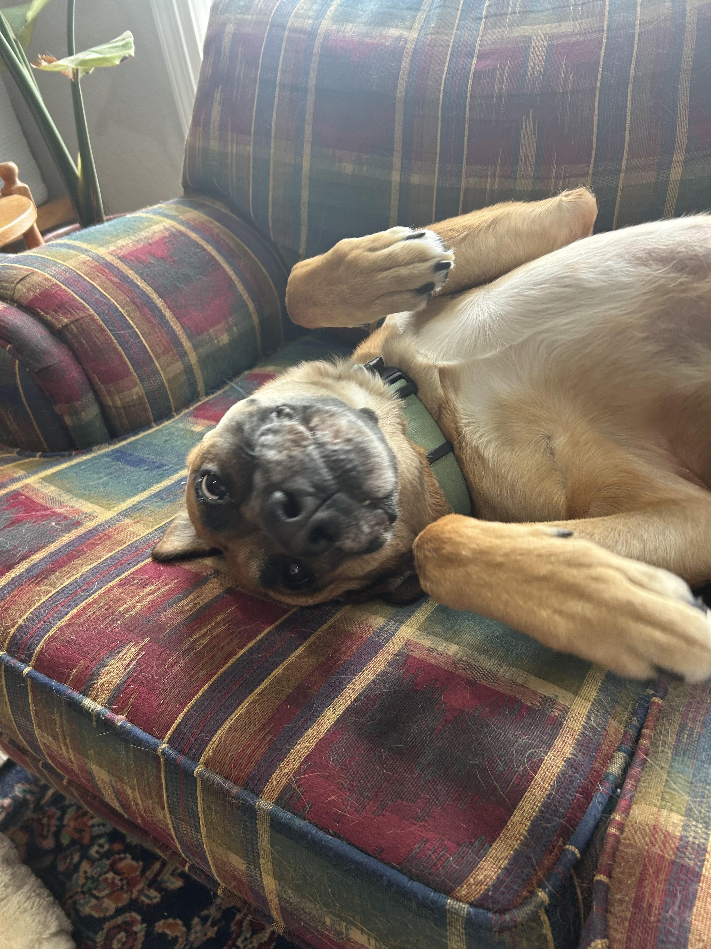
Here’s Athena

Slide 15
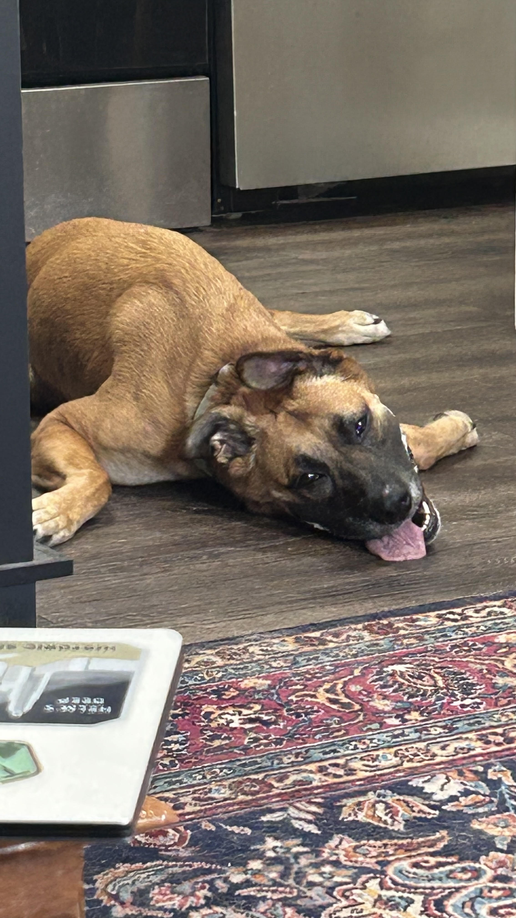
Athena

Slide 16
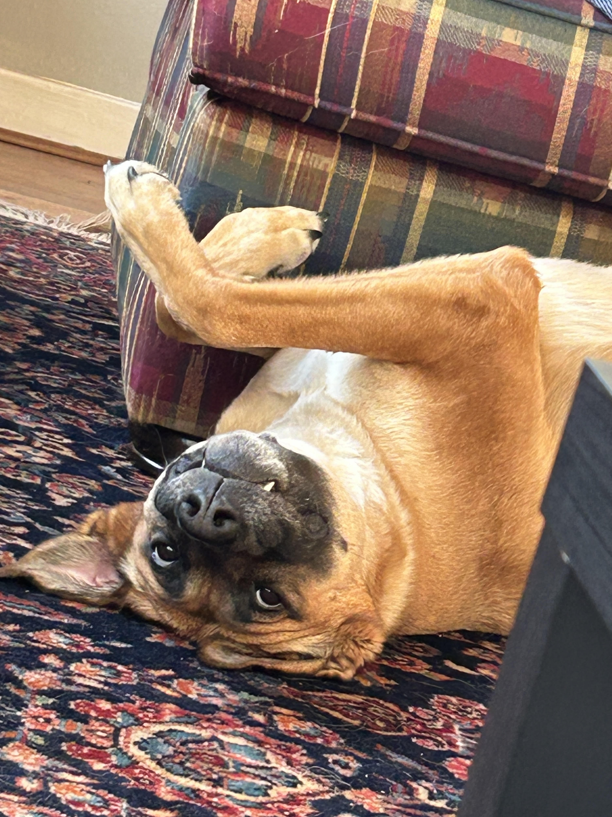
Athena

Slide 17
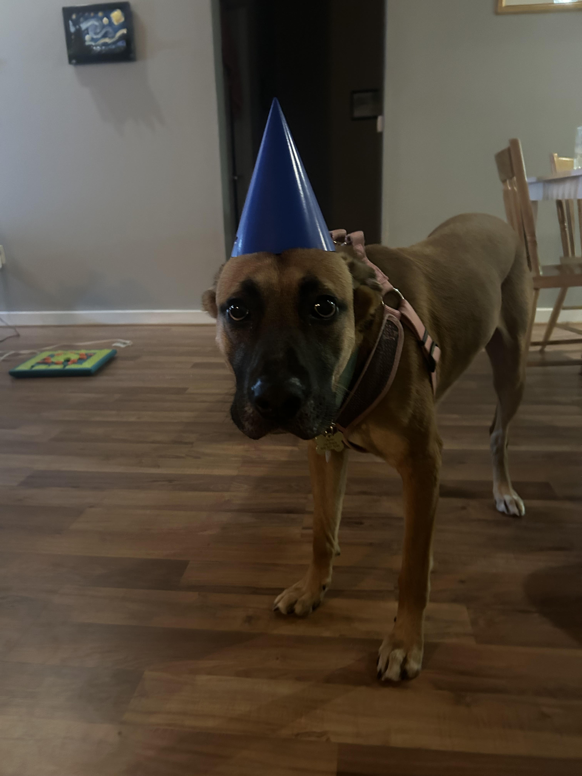
Athena

Slide 18
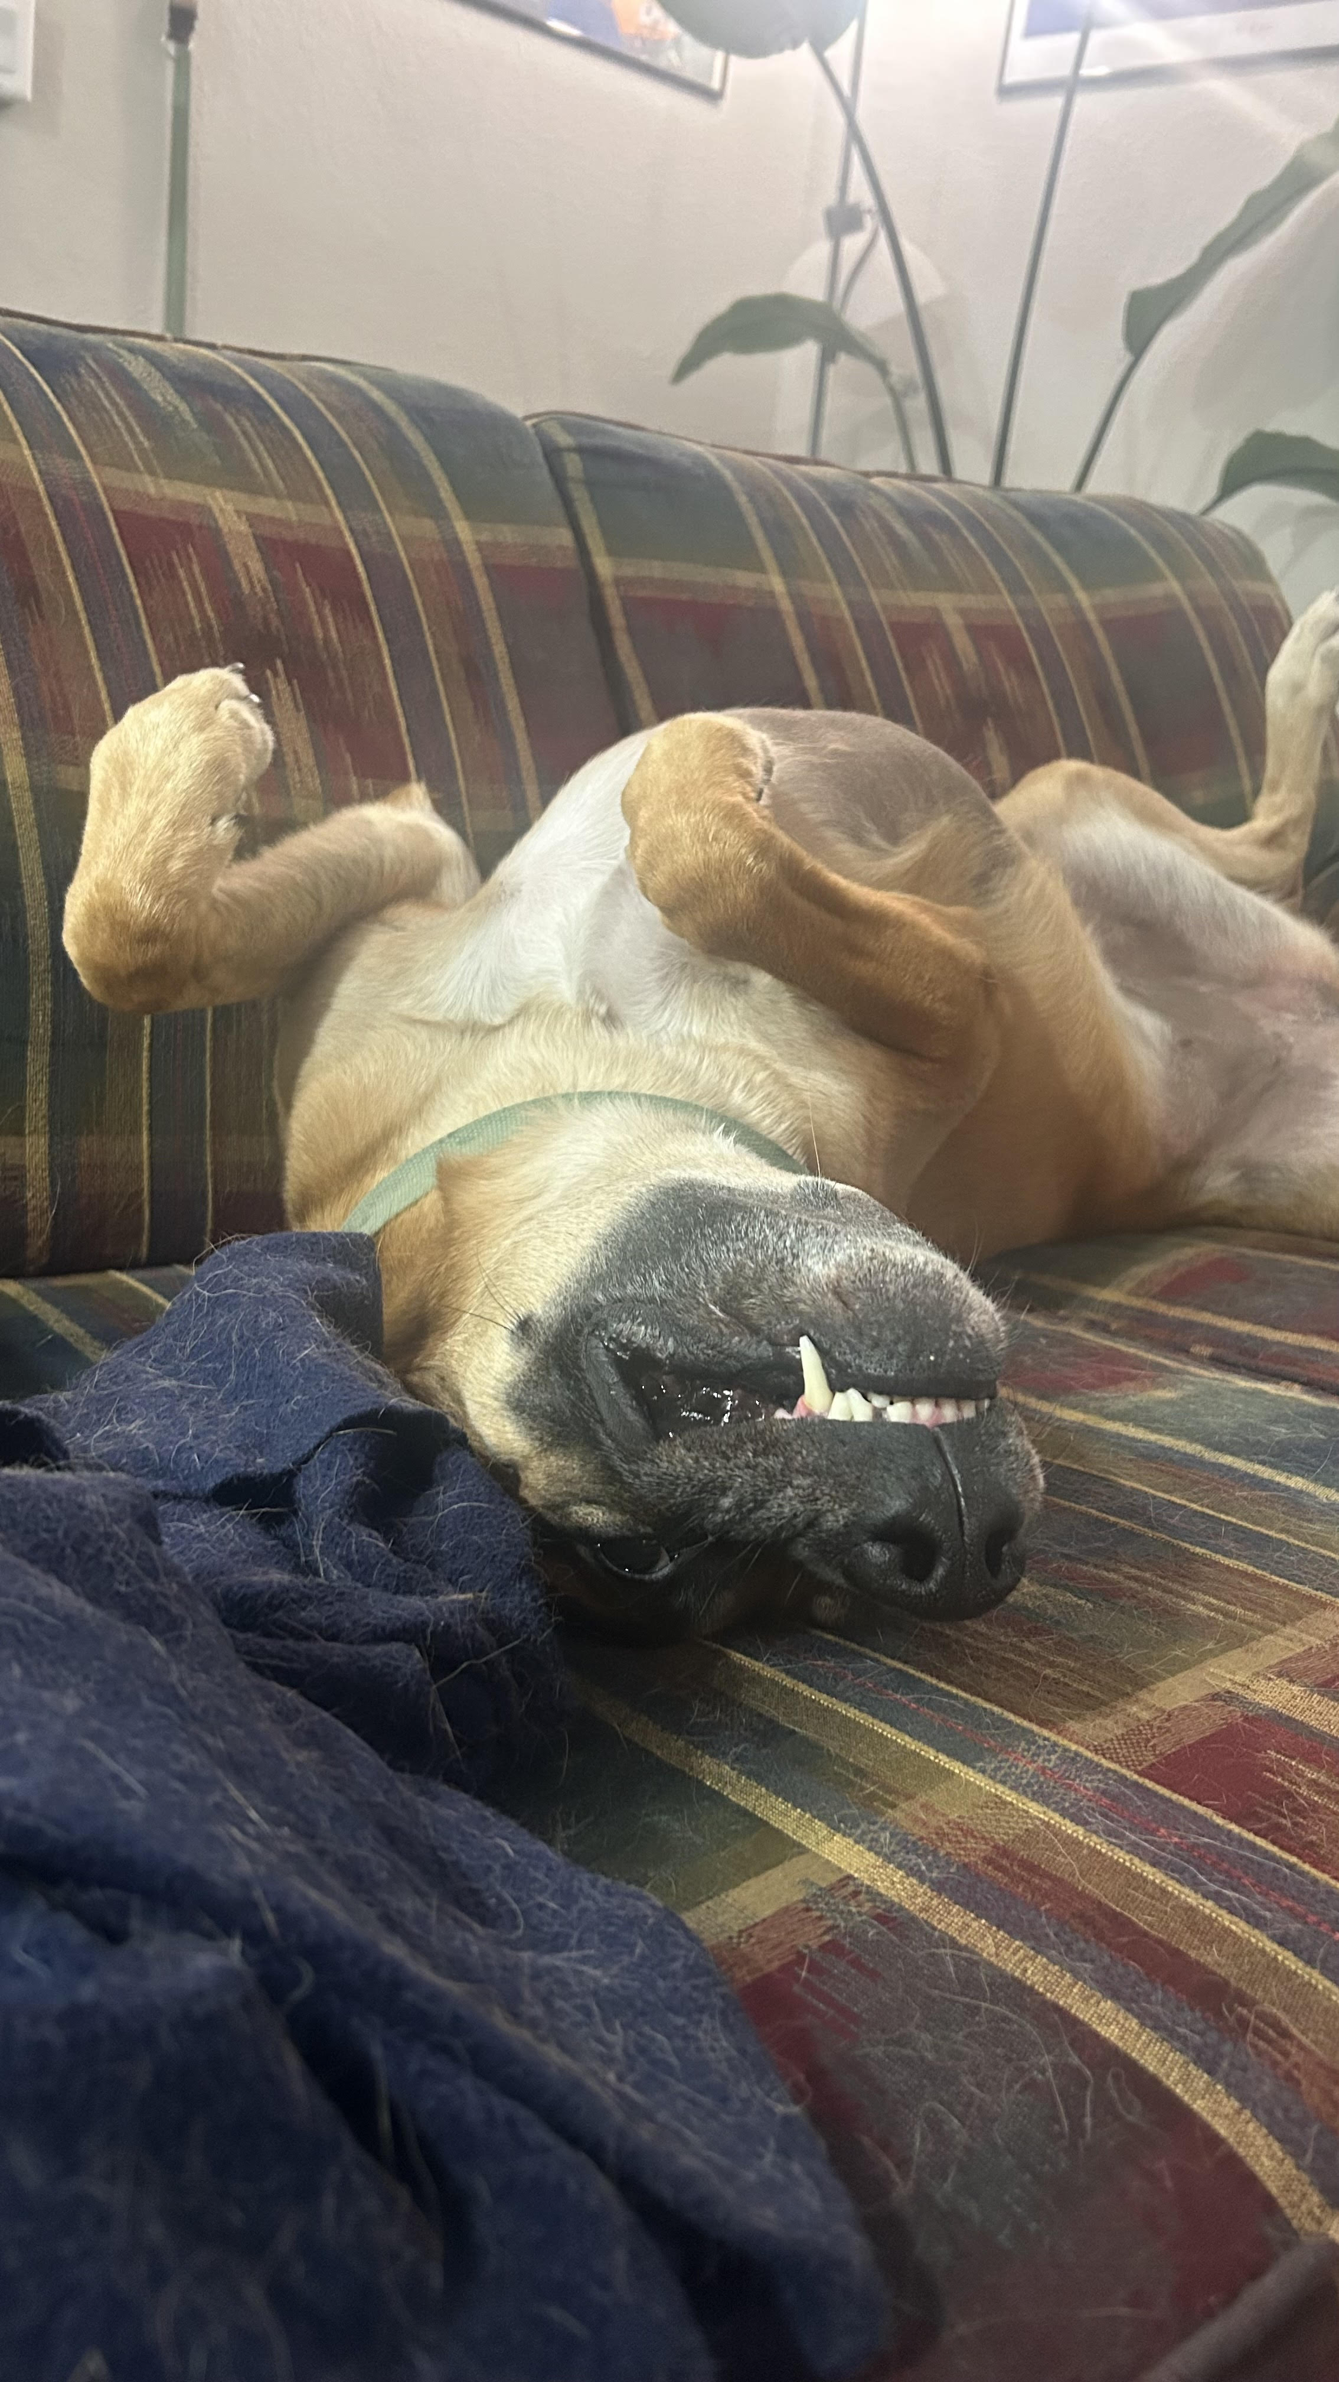
Athena

Slide 19
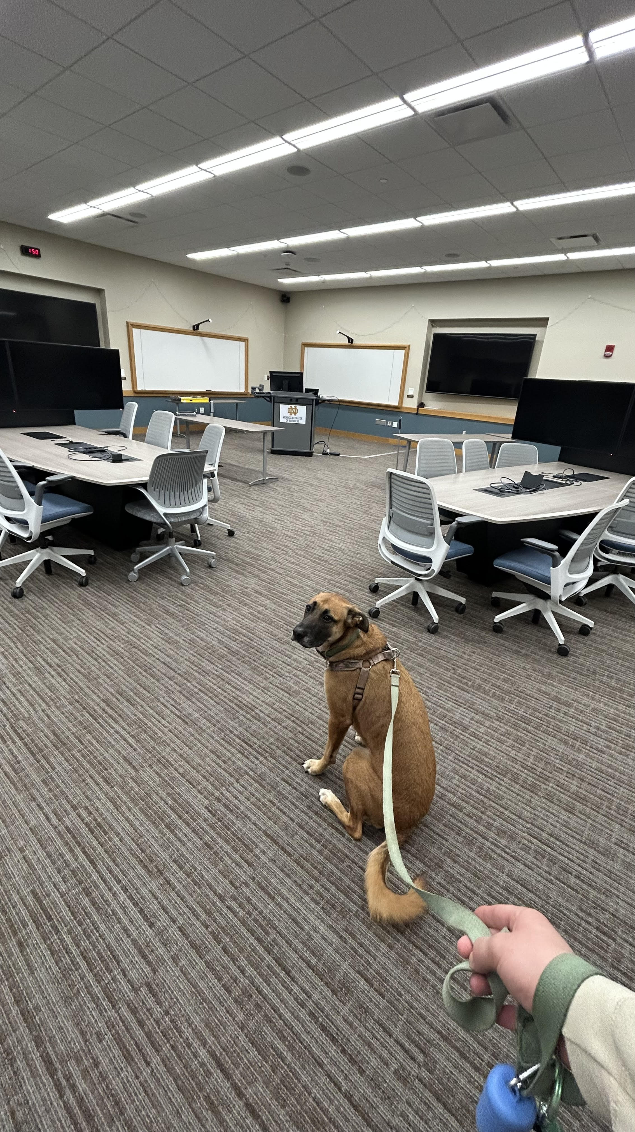
Uploading Athena into the model

Slide 20
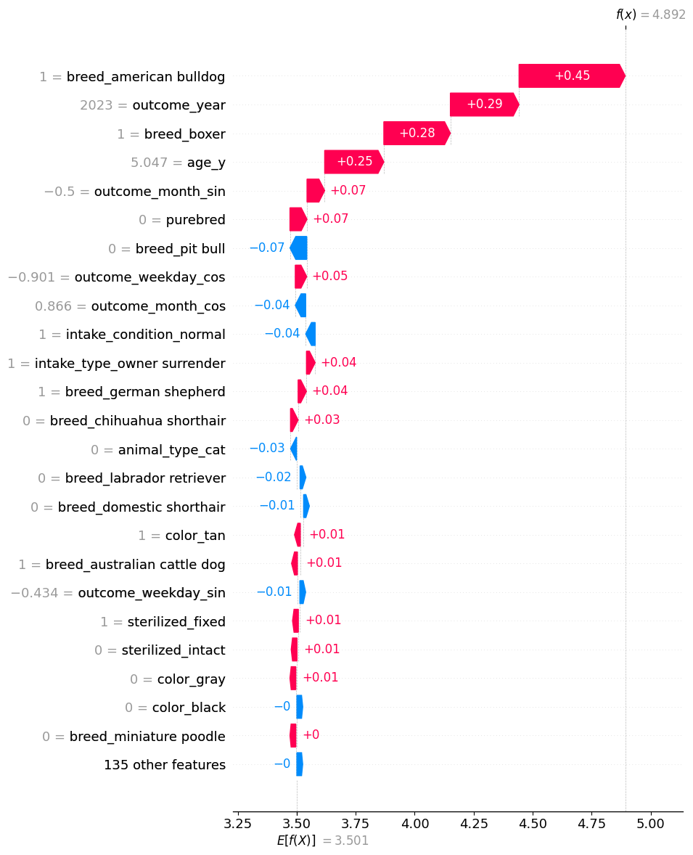
Athena’s predicted shelter stay based on the gamma deviance model
Athena’s breeds increased her predicted stay significantly, as well as being a mixed breed
not being a pit bull decreased her predicted stay
her older age predicted a longer stay
2023, Nov, & Friday predict a longer stay
Predicted shelter stay: 4.9 days
Actual shelter stay: ~298 days ☹
Conclusion: The model is PERFECT and the World is WRONG

Slide 21
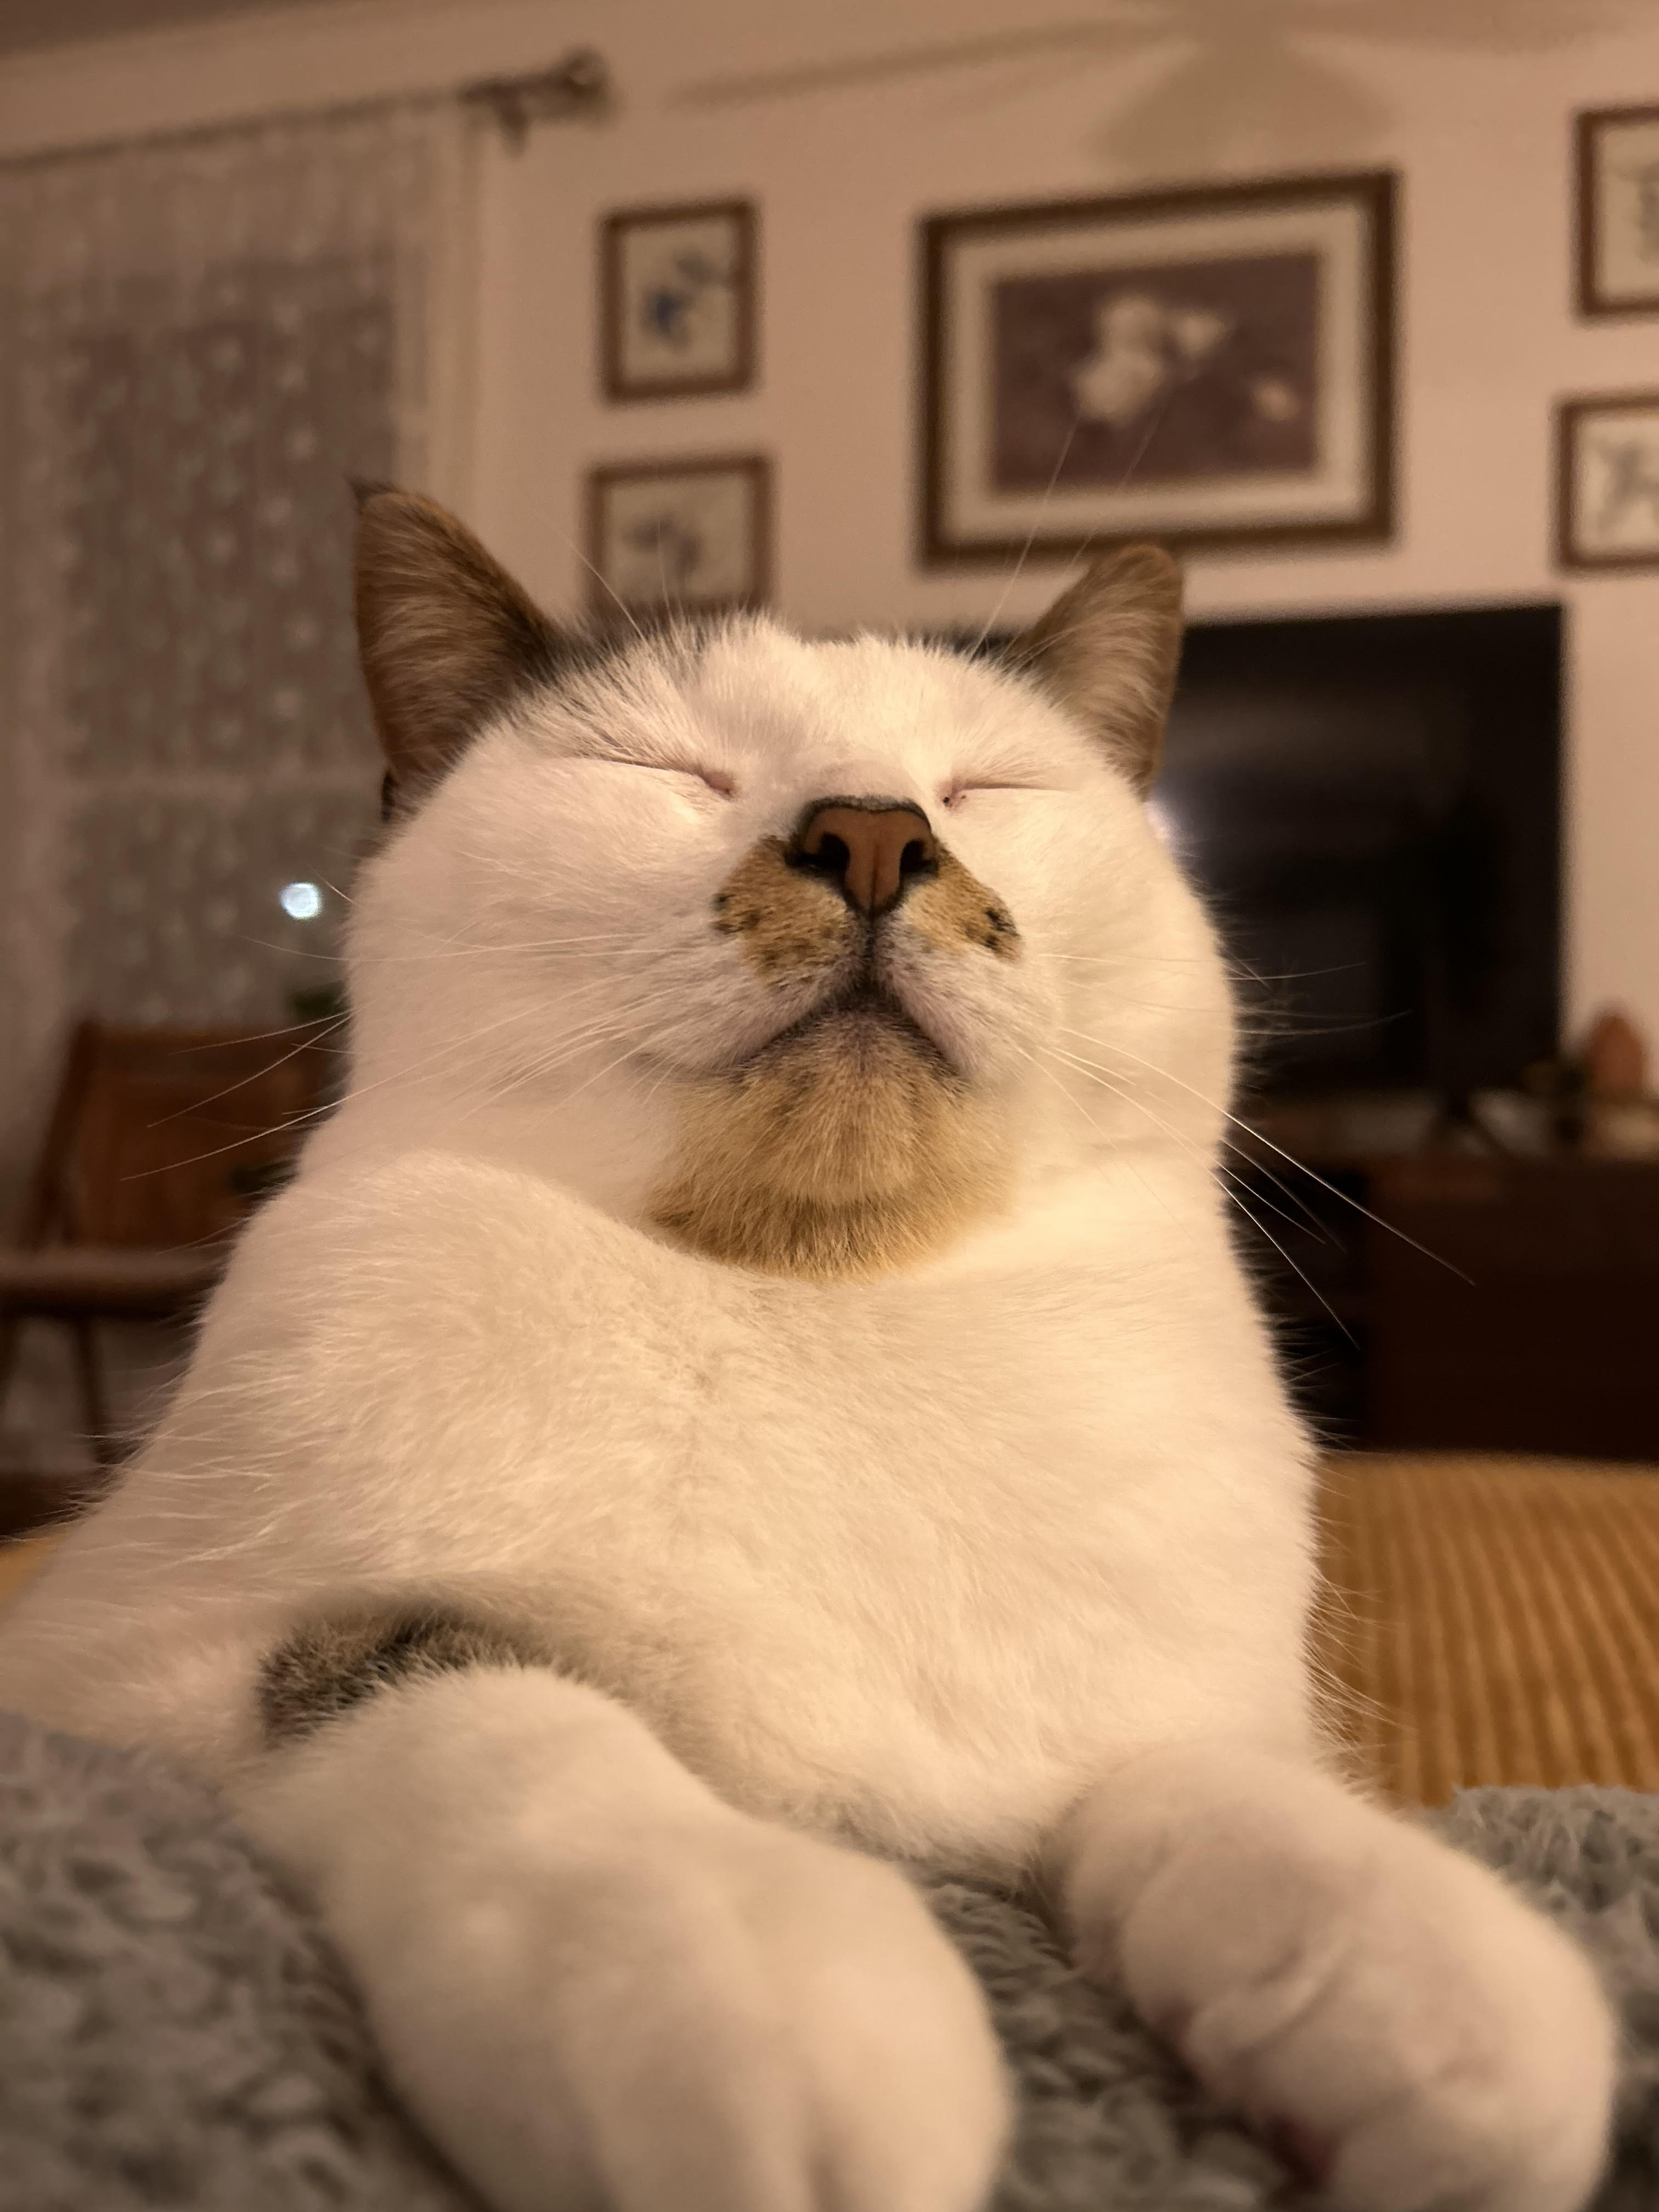
What about my friends’ pet cat, Mr. Chocolate Milk Mustache Face?

Slide 22
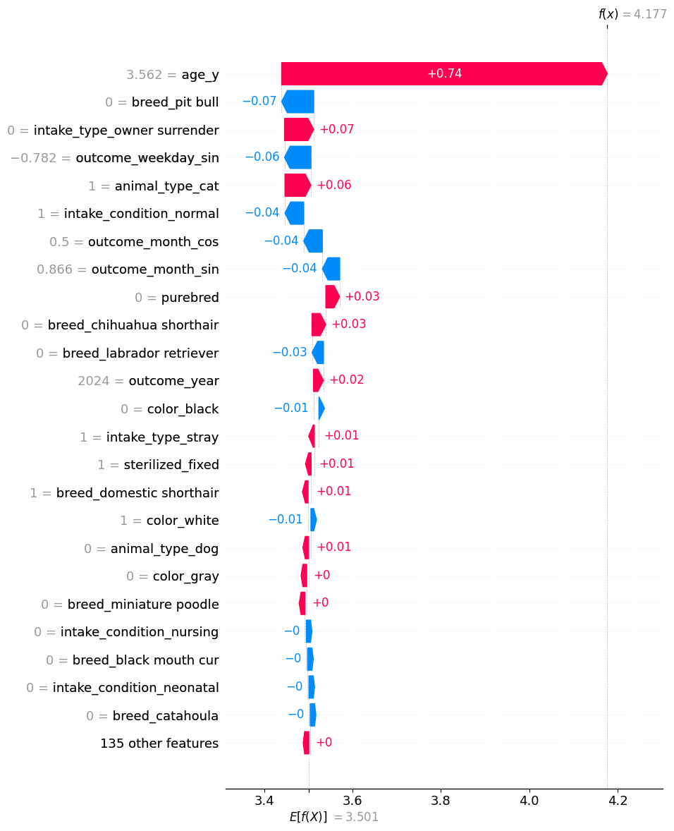
Choccy’s predicted shelter stay based on the gamma deviance model
Choccy’s age is the strongest factor, increasing his predicted stay
Not being a pit-bull decreased expected stay, while being a cat increased it
Not being an owner surrender increased expected stay
Outcome month of Feb, weekday Sunday decreased expected stay
Predicted shelter stay: 4.17 days
Actual shelter stay: ~62 days ☹
In general, the model does not handle outliers very well

Slide 23
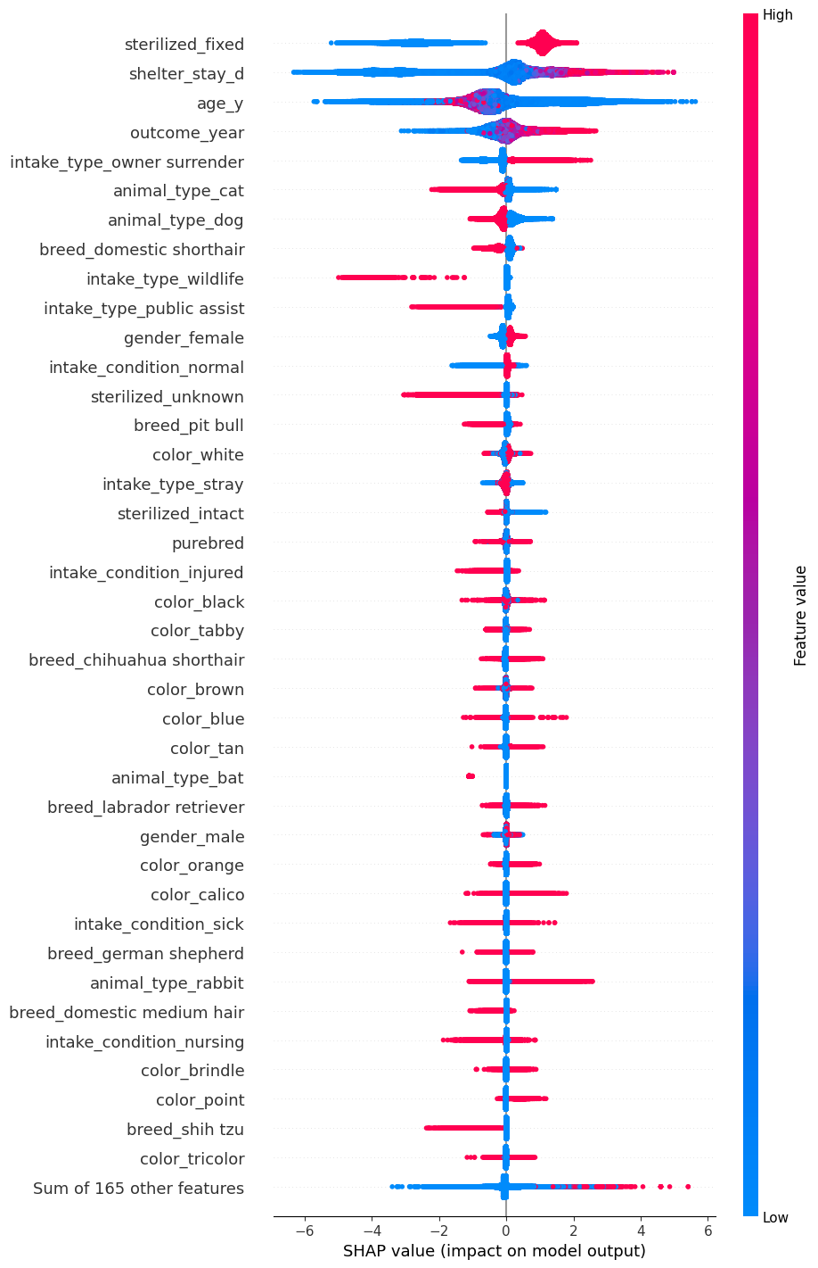
Model 3 looks only to identify the strongest factors that predict adoption. These are the strongest factors that predict an adoption outcome (top 20)
sterilization predicts adoption
shelter policy?
longer shelter stay predicts adoption
non-adoption outcomes happen quickly
previously homed animals more likely to be adopted
‘intake type: owner surrender’
cats and dogs both are less likely to be adopted, wildlife no adopted
other animals (birds, rabbits) skew
wildlife never adopted
females more likely to be adopted
pit bulls are again unfavored

Slide 24
Secondary factors that predict an adoption outcome (21-40)
chihuahuas and labs are slightly more likely to be adopted, while shih tzus are much less likely
bats are NEVER adopted, while rabbits are more likely
orange and point colored animals are more likely to be adopted
point coat example: Siamese cat
male animals are somewhat less likely to be adopted
sick animals are somewhat less likely to be adopted
large range of impact

Slide 25
Recommendations for better shelter outcomes
Prioritize efforts for less desirable animals
pit bulls, black coat animals, bulldogs, boxers, older animals, males
Focus on basic training and socialization for strays
animals homed previously and used to people have better outcomes
Promote rabbits as pets, as rabbits tend to stay in a shelter longer
Consider introducing a wildlife rehabilitation & release program, as wildlife that end up in the animal shelter are almost always euthanized

Slide 26
With more time, there are a few more things I would have liked to try
K-Means clustering to group animals and see trends
Modeling for just dogs and cats, who make up most of the dataset, and whose results people probably care about the most
Deal with more issues in the dataset
collinearity: e.g. animal type and breed, age and intake conditions (neonatal)
group breeds and coat colors into buckets for a more streamlined model
Remove time components from the model
It would be more meaningful to simply visualize these trends aggregated over time

Slide 27

Questions?
Consider adopting an animal once that signing bonus cashes!

